Slide 1
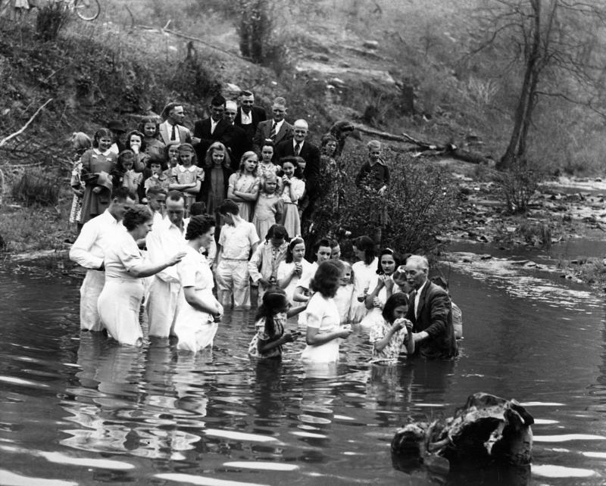

Slide 2
Series:
Incarnational Ministry
Message:
Incarnational Ministry Part 2
Luke 10: 1-24
(Focus verses 1-3)

Slide 3
Incarnational Ministry - Part 2
Luke 10:1-3
1 Now after this the Lord
appointed seventy others,
and sent them in pairs ahead of Him to every city and place
where He Himself was
going to come

Slide 4
Incarnational Ministry - Part 2
Luke 10:1-3
2 And He was saying to them,
“The harvest is plentiful,
but the laborers are few; therefore beseech the Lord of the harvest
to send out laborers
into His harvest.

Slide 5
Incarnational Ministry - Part 2
Luke 10:1-3
3 Go; behold, I send you out as lambs in the midst of wolves.

Slide 6
Incarnational Ministry - Part 2
Introduction:
Review of Incarnational Ministry
part 1

Slide 7
Incarnational Ministry - Part 2
Introduction:
The concept of incarnation is revealed
in John 1:1,14.

Slide 8
Incarnational Ministry - Part 2
John 1:1 & 14
1 In the beginning was the Word,
and the Word was with God,
and the Word was God.
14 And the Word became flesh,
and dwelt among us,
and we saw His glory,
glory as of the only begotten
from the Father, full of grace and truth.

Slide 9
Incarnational Ministry - Part 2
Introduction:
In this passage in Luke 10
Jesus sends out 70 other disciples
in His Name to do ministry.
From His instructions to these 70 and their experiences we can see
12 principles of Incarnational ministry that Jesus would desire of us today
as His Body.

Slide 10
Incarnational Ministry - Part 2
Introduction:
Last week we began our study
looking together at the first 2 principles.

Slide 11
Incarnational Ministry - Part 2
Introduction:
The Principle of Strategy-(vs. 1)
(Appointed) (Sent) (Groups of 2) (Commissioned)

Slide 12
Incarnational Ministry - Part 2
Introduction:
The Principle of Vision-(vs. 2a)
(Harvest-plentiful)
Problem not in the harvest’s potential. Problem is a painful truth,
there simply are not enough laborers working with a focus on the harvest.

Slide 13
Incarnational Ministry - Part 2
Introduction:
Today we look at principle 3 & 4

Slide 14
Incarnational Ministry - Part 2
3. The Principle of Prayer (vs. 2b)

Slide 15
Incarnational Ministry - Part 2
These 70 disciples are not told here
to pray for the lost people they may encounter on their journey.
They are told to pray for the
Lord of the harvest to send out
more laborers.

Slide 16
Incarnational Ministry - Part 2
God’s Word and His will
does encourage us to pray for the lost

Slide 17
Incarnational Ministry - Part 2
7 Examples of prayers for the lost:

Slide 18
Incarnational Ministry - Part 2
Pray for God to draw the person to Himself –John 6:44
Pray the person will seek after God Acts 17:27-Athens
Pray the person will hear/accept the Word
as from God

Slide 19
Incarnational Ministry - Part 2
Pray the Lord breaks through the spiritual blindness
Pray the Holy Spirit would convict them of sin & the need of forgiveness found only in Jesus
Pray for opportunity to share Gospel
with this person
Pray the person would trust fully
in Christ alone

Slide 20
Incarnational Ministry - Part 2
However, this was
not Jesus’ focus of prayer for this group.
Jesus wanted them to pray for the greater need-
laborers to work the harvest.
It is same prayer priority for us-
laborers for the Harvest

Slide 21
Incarnational Ministry - Part 2
God alone can prepare the hearts
of those who will accept this call
of taking the Gospel to the lost.

Slide 22
Incarnational Ministry - Part 2
Jesus knows that if we fervently pray (beseech) for God to send someone into the field, God will work on our hearts.

Slide 23
Incarnational Ministry - Part 2
As we hear God say who will go we,
like Isaiah, once we have seen the need through God’s eyes, will say,
“here am I Lord send me!”
Isaiah 6: 5-8

Slide 24
Incarnational Ministry - Part 2
Isaiah was broken by his sin
and the sin of his people.
Once He experienced personal cleansing (God removed his “unworthy” excuse)
he was burdened for his people
and committed to go.

Slide 25
Incarnational Ministry - Part 2
No one is worthy to go
and represent Christ.
Yet as we pray God cleanses us
and we go based upon His worth
and in His Name.

Slide 26
Incarnational Ministry - Part 2
Only in prayer can God give us
the burden we need to be able
to persevere once we have determined
to go!

Slide 27
Incarnational Ministry - Part 2
Part of our Vision
as the Fairview Family is to see God
develop a growing and effective
prayer ministry.
Some aspects of this vision are to assist and to strengthen our current
prayer ministries.

Slide 28
Incarnational Ministry - Part 2
As God allows we would love to have
a room set apart specifically for prayer. We also desire to see effective, passionate prayer for the lost
in small groups

Slide 29
Incarnational Ministry - Part 2
All of our prayer times together are vital. We desire to see focused, specific, empowering prayer for harvest laborers, for the lost, and for the burdens
facing the family of God.

Slide 30
Incarnational Ministry - Part 2
Our vision is to actually spend time
in prayer talking and listening to God. Too often we can easily talk about prayer without really praying.
The power comes from praying.

Slide 31
Incarnational Ministry - Part 2
The power comes from focusing prayer towards God’s heart desires.
His priorities are laborers
and seeking the lost.
He truly cares about our hurts
and burdens but they are not
His top priorities.

Slide 32
Incarnational Ministry - Part 2
If Jesus led your personal prayer time
or made out our prayer lists
in our classes or our Wednesday night prayer list would they be different?
How would it be different?

Slide 33
Incarnational Ministry - Part 2
4. The Principle of Going (vs. 3)

Slide 34
Incarnational Ministry - Part 2
After telling these teams of two to pray Jesus then said “Go your ways

Slide 35
Incarnational Ministry - Part 2
There is a time to plan, a time to pray, and a time to go!
We love to plan and like to pray.
We seldom go.

Slide 36
Incarnational Ministry - Part 2
When Jesus uses the term “go”
He is saying’ “As you are going”
just as He did in Matthew 28: 19.

Slide 37
Incarnational Ministry - Part 2
We need a “Go” mentality.
Alert, ready to share

Slide 38
Incarnational Ministry - Part 2
Where do we go?

Slide 39
Incarnational Ministry - Part 2
We can start with those we regularly encounter on our journeys through life- family, neighbors, and work, places where we shop, where we do business, where we go for entertainment,
where we go when we visit
doctors or dentists.

Slide 40
Incarnational Ministry - Part 2
In other words everywhere we go
where we will be around people
is a strategic appointment
and we are sent there by God
as His ambassador and carrier
of the Good News.

Slide 41
Incarnational Ministry - Part 2
Jesus speaks this “Go your ways”
as a command.
This means He desires us to be intentionally incarnational.
We are to be looking for His open doors in these relationships and
for opportunities to share
the Gospel.

Slide 42
Incarnational Ministry - Part 2
Sometimes the doors are opened
because we courageously bring up
the subject of Jesus

Slide 43
Incarnational Ministry - Part 2
When Jesus said I send you the focus
was on the word “I”.
Jesus is sending us.
There are many available tools
but what is most important
is to know we go in His authority
and in His presence

Slide 44
Incarnational Ministry - Part 2
Where will you and I be going this week? Who will need the hope, joy,
and love of Jesus
where you and I will be going?
As we go pray for Harvest Vision.

Slide 45
Incarnational Ministry - Part 2
Applications

Slide 46
Incarnational Ministry - Part 2
To pray and go requires
we first have our own relationship
with Jesus

Slide 47
Incarnational Ministry - Part 2
Have you placed your trust in the truth that Jesus Christ died on the cross
for your sins and rose from the dead according to the Scriptures?

Slide 48
Incarnational Ministry - Part 2
Have you accepted God’s offer,
by His Grace, of forgiveness
and a new life?
If not, will you choose to trust
in Jesus Christ alone today?

Slide 49
Incarnational Ministry - Part 2
As a disciple/follower of Jesus Christ
we are called to pray for laborers?
Will you commit to pray earnestly
for God to send laborers?

Slide 50
Incarnational Ministry - Part 2
As you go will you ask God to open your eyes to see the Harvest field
of your home, community, and world?

Slide 51
Series:
Incarnational Ministry
Message:
Incarnational Ministry Part 2
Luke 10: 1-24
(Focus verses 1-3)

